Slide 1
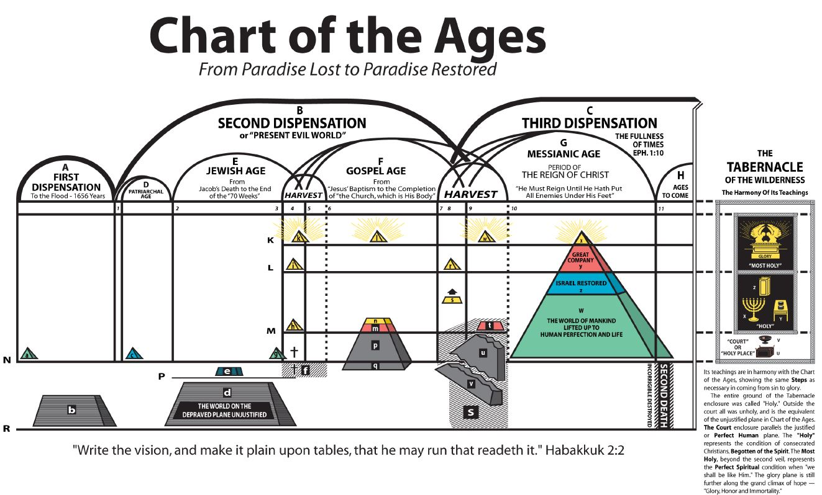
WHAT IS THE MEANING OF THIS CHART?
PART I

Slide 2
WHO DEVELOPED THE CHART OF THE AGES?
Let us look at some history…

Slide 3
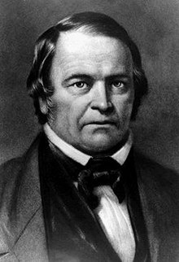
William Miller (1840’s)
Chart of Daniel’s Visions
2520
years
Medo Persia
Greece
Rome
Babylon
1260
years

Slide 4
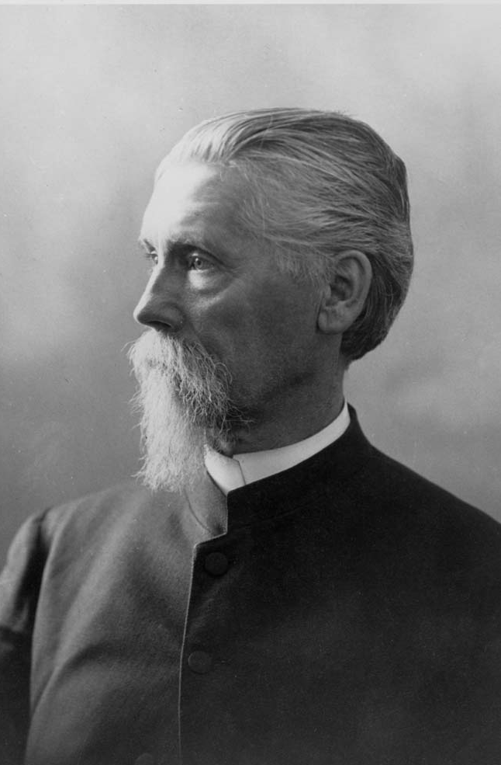
From the “Day Dawn”
J. H. Paton

Slide 5
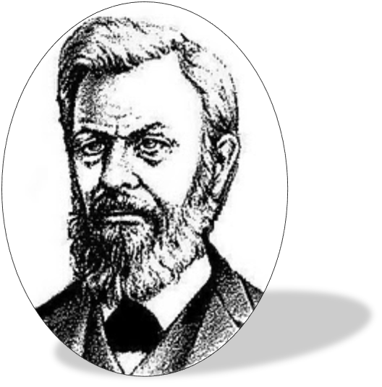
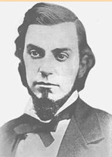
From “The Three Worlds”
Nelson Barbour
C.T. Russell

Slide 6
CHARLES RUSSELL
The “CHART OF THE AGES” first appeared in “Food for Thinking Christians”
in the July and August issue (1881)
(What is the difference between this chart and the previous three?)
What hast thou that thou didst not receive…
(I COR. 4:7)

Slide 7
WHY WAS THE CHART OF THE AGES DEVELOPED?
The Chart Of The Ages was developed in order to aid the mind, through the eye (a visual aid),
In understanding something of the progressive character of God's plan…
And the progressive steps which must be taken by all who ever attain the complete "change" from the human to the divine nature.
(Let us remember these two points)

Slide 8
WHAT IS THAT CHART ON YOUR WALL?
This “Chart Of The Ages” is an
“illustration of the Plan of God
for the world’s salvation”

Slide 9
Habakkuk 2:2
Write Down the Vision and Make it Plain Upon Tables, That Everyone May Read it Fluently.
Proverbs 29:18
Where there is no vision, the people perish…

Slide 10
Progressive Steps
The Plan of God, with reference to man, spans three great periods of time, beginning with man’s creation and reaching into the illimitable future.
Progressive Character

Slide 11
WHAT IS A DISPENSATION?
DISPENSATION = (in Christian theology) a divinely ordained order prevailing at a particular period of history.
(Sort of an administration)
Notes:
IN THE back of this volume is attached a chart representing the plan of God for the world's salvation. By it we have sought to aid the mind, through the eye, in understanding something of the progressive character of God's plan, and the progressive steps which must be taken by all who ever attain the complete "change" from the human to the divine nature.

Slide 13
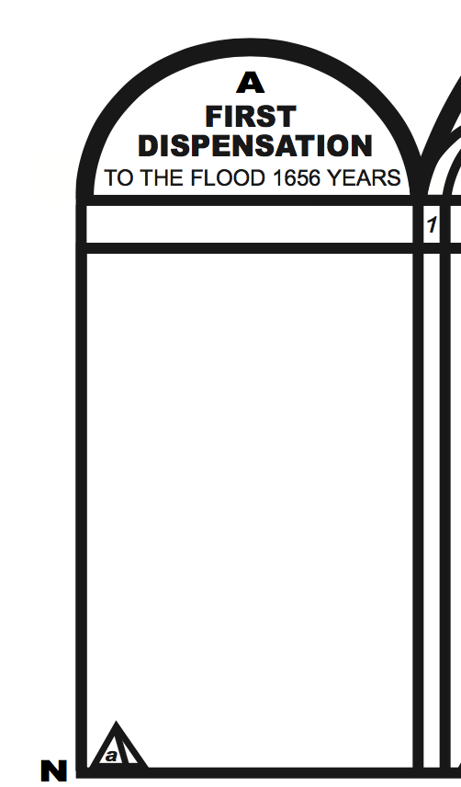
Dispensation “A” - - Is a period of 1656 years from the creation of Adam to the day the flood dried up. And this time period can easily be proven through the scriptural record.
II Peter 3:6 - - Whereby the world that then was, being overflowed with water, perished:
Paul says in Hebrew 2:5: Unto the angels hath he not put in subjection the world to come.

Slide 15
Dispensation B is referred to by Jesus as “this world”
It is under the limited usurped control of the adversary. II Cor. 4:4 In whom the god (Satan) of “this world” hath blinded the minds of them which believe not…
Galatians 1:4 - - (Jesus) Who gave himself for our sins, that he might deliver us from this present evil world...
Dispensation “B” - - Lasting from the flood to the commencement of the Millennial reign of Christ.

Slide 17
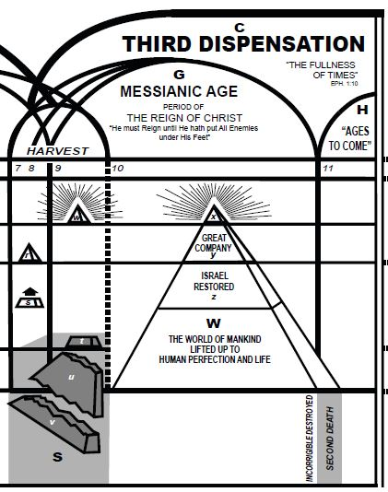
II Peter 3:13: Nevertheless we, according to his promise, look for new heavens (new spiritual power) and a new earth (new social order), wherein dwelleth righteousness. Lasting from the beginning of Christ’s reign for untold ages…ages to come…Eph. 2:7
Ephesians 1:10: That in the dispensation of the fulness of times he might gather together in one all things in Christ, both which are in heaven, and which are on earth: even in him:
Paul says in Hebrew 2:5: Unto the angels hath he not put in subjection the world to come.
Notes:
IN THE back of this volume is attached a chart representing the plan of God for the world's salvation. By it we have sought to aid the mind, through the eye, in understanding something of the progressive character of God's plan, and the progressive steps which must be taken by all who ever attain the complete "change" from the human to the divine nature.

Slide 18
Each age has its part to accomplish, necessary to the complete development of God’s plan as a whole.
What is an Age?
Age - A distinct period of history.
(Plug in the definition)

Slide 21
“N” Represents the plane of human perfection as
Indicated by the small Pyramid “a” which represents
the perfect man Adam.
“R” Represents the plane of sin and death to which
Adam fell along with all of his posterity. This plane
corresponds to the broad road which leadeth to destruction

Slide 23
Adam
Adam and his posterity after the fall

Slide 25
How can Abraham and the other Patriarchs be represented on Plane N…the plane of human perfection? They were imperfect men.
Abraham and other Patriarchs
They were justified before God by their faith. They were not justified to life, not Justified even to son ship. They were justified to God’s friendship, favor and supervisory care. (James 2:23)

Slide 27
1845 Years
The typical sacrifices of bulls and goats during the Jewish Age from the giving of the law until Jesus nailed it to his cross cleansed Israel after the flesh (not really) but typically. At the cross the typical justification ended by the institution of the “better sacrifices” which actually take away the sin of the world and make the comers thereunto perfect Exodus 19:5, Heb 9:6-7, 10:1
“P” Shows the Typical Justification of Natural Israel.

Slide 29
The small pyramid “g” represents Jesus as a perfect man.
John 1:14 And the Word was made flesh, and dwelt among us, (and we beheld his glory, the glory as of the only begotten of the Father,) full of grace and truth.

Slide 32
At 30 years of age Jesus gave up his human will and accepted the will of his heavenly Father. After having made this consecration, he symbolized it by water baptism. Jesus was anointed with the Holy Spirit and begotten to the divine nature, as represented by pyramid “h”. Our Lord Jesus Christ spent three and one-half years on plane “M”. The plane of spirit begettal. Hebrews 10:7,9; Matthew 3:13-17; John 1:29-34
AD 29
1st advent

Slide 33
AD 33 1/2
Jesus Raised

Slide 34
(Redemption of the Jews)
Gal 3:13 Christ hath redeemed us from the curse of the law, being made a curse for us: for it is written, Cursed is every one that hangeth on a tree:

Slide 35
Pyramid “i” After being dead for parts of three days, our redeemer was resurrected a glorious divine spirit being.
John 20:17 Jesus saith unto her, touch me not; for I am not yet ascended to my Father: but go to my brethren, and say unto them, I ascend unto my Father, and your Father; and to my God , and your God.

Slide 36
Pyramid “k” Jesus set down with his Father on his throne.

Slide 37
“Plane L” (I Cor. 15:44) It is sown a natural body; it is raised a spiritual body. There is a natural body, and there is a spiritual body.
PLANE “L”
“L” Represents the plane of spirit Nature. Those of the overcoming class will be raised spirit beings. (I Cor. 15:44,52)

Slide 38
Pyramid “l”
Jesus, During the Gospel Age
John 14:3 And if I go and prepare a place for you ; I will come again, and receive you unto myself; that where I am, there ye may be also.

Slide 40
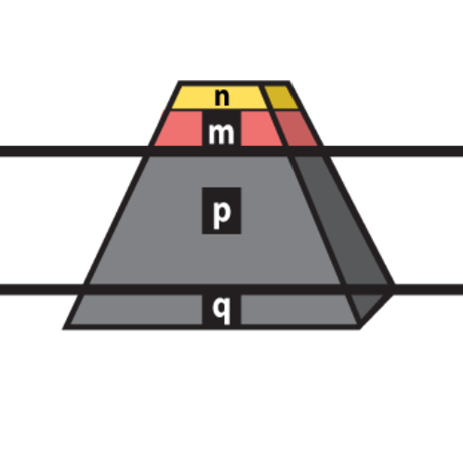
This partial pyramid n, m, p, q united represents the Nominal Church down through the gospel age, claiming to be the body of Christ.
The “little flock” of consecrated children of the heavenly father down through the Gospel Age.
Rev. 2:10 Be thou faithful unto death and I will give thee a crown of life
Matt 25:1-3 “And five of them were wise, and five were foolish. They that were foolish took their lamps, and took no oil with them.”
PLANE “M”
n
Those of the “p” class receive the grace – favor – “justification” of God in vain. 2 Cor. 6:1
m
Wolves in Sheep’s clothing
p
PLANE “N”
q

Slide 41
END OF PART I

